Slide 1



Introduction to Energy Consumption Monitoring
Understand how energy monitoring can provide visibility into your energy usage patterns and identify opportunities for savings.
by Snehitha

Slide 2
Benefits of Energy Monitoring
Cost Savings
Sustainability
Reduce energy bills by pinpointing inefficiencies.
Decrease your carbon footprint and environmental impact.
Optimization
Awareness
Identify high-consumption appliances and adjust usage.
Gain insight into your energy usage habits.

Slide 3
Types of Energy Monitoring Devices
Whole-Home Monitors
Plug-Level Monitors
Utility Meters
Track total energy consumption for an entire property.
Monitor individual appliances and devices.
Provide data from your electricity, gas, or water utility.

Slide 4
Selecting the Right Monitoring Solution
1
Budget
2
Compatibility
Consider upfront and ongoing costs.
Ensure devices work with your home's electrical setup.
3
Reporting
4
Connectivity
Prioritize detailed data and user-friendly dashboards.
Choose wireless or wired options based on your needs.

Slide 5
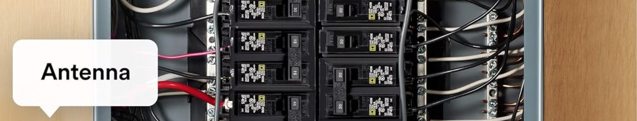



Installation and Setup
Mount Sensors
Connect to Network
Configure Settings
Place monitors on breakers or appliances.
Sync devices to your home WiFi.
Customize monitoring thresholds and notification preferences.

Slide 6




Analyzing Energy Consumption Data
Visualize
Track
Customize
Benchmark
Use charts and graphs to spot trends.
Monitor usage by day, week, or month.
Set alerts and reporting preferences.
Compare your usage to similar properties.

Slide 7

Identifying Opportunities for Savings
Reduce Waste
1
Unplug unused appliances and adjust thermostat settings.
2
Upgrade Equipment
Replace inefficient HVAC, lighting, and appliances.
Optimize Usage
3
Schedule high-consumption tasks during off-peak hours.

Slide 8
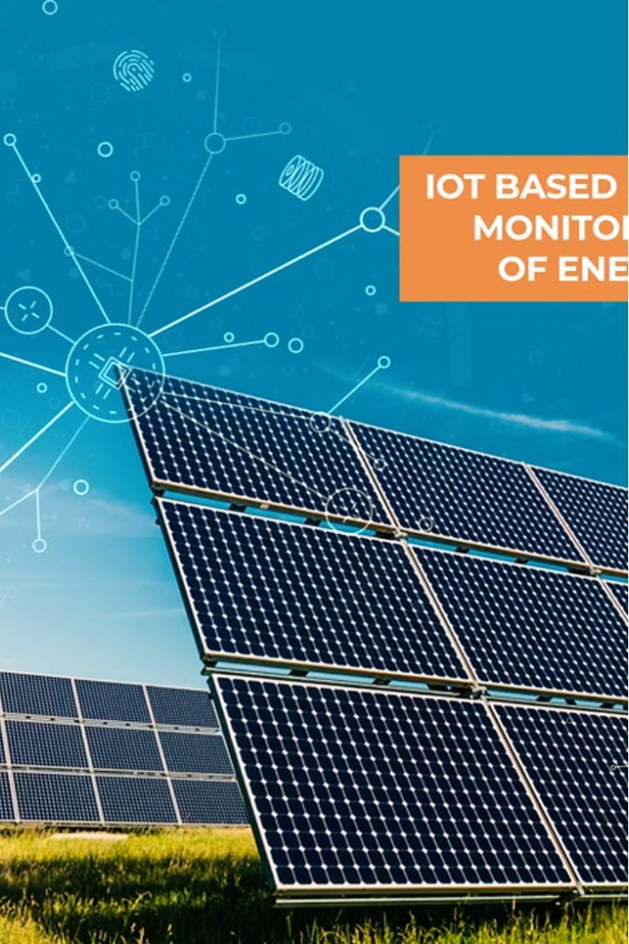
Conclusion and Next Steps
Energy monitoring empowers you to take control of your energy use and make data-driven decisions to save money and reduce your environmental impact.

